Slide 1
Module #01 : Introduction to Verilog HDL
Verilog HDL is one of the two most common Hardware Description Languages (HDL) used by integrated circuit (IC) designers. The other one is VHDL.
Designs described in HDL are technology-independent, easy to design and debug, and are usually more readable than schematics, particularly for large circuits.
Verilog is used as an input for synthesis programs which will generate a gate-level description (a netlist) for the circuit.
The way the code is written will greatly effect the size and speed of the synthesized circuit
Some Verilog constructs are not synthesizable. (eg. delay)
Non-synthesizable constructs should be used only for test benches.
Note: “Verilog is NOT a Programming Language. It is a Hardware Description Language !!!”
Programming Language : Let the hardware perform a particular function
HDL : Design that Hardware !!

Slide 2
Module #01 : Introduction to Verilog HDL
There are two types of code in most HDLs:
1) Structural, which is a verbal wiring diagram without storage.
Example 1.1:
assign a=b & c | d;
assign d = e & (~c);
2) Procedural, which is used for circuits with storage, or as a convenient way to write conditional
logic.
Example 1.2:
always @(posedge clk) // Execute the next statement on every rising clock edge.
count <= count+1;
if and case statements are only allowed in procedural code. As a result, the synthesizers have been constructed which can recognize certain styles of procedural code as actually combinational.

Slide 3
Module #01 : Introduction to Verilog HDL
Verilog can be used to describe designs at four levels of abstraction:
(i) Switch level (the switches are MOS transistors inside gates).
(ii) Gate level (interconnected AND, NOR etc.).
(iii) Register transfer level/Data Flow Level (RTL uses registers connected by Boolean equations).
(iv) Algorithmic level/Behavioral Level (much like c code with if, case and loop statements).

Slide 4
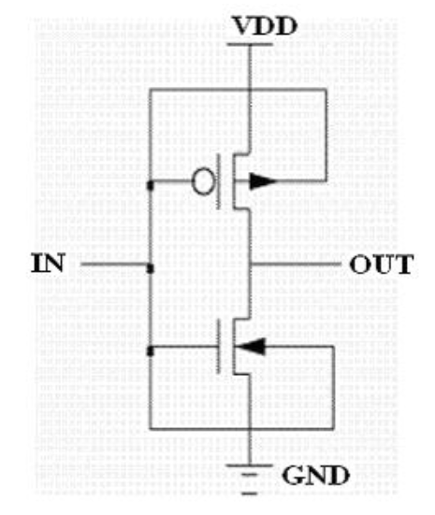
Module #01 : Introduction to Verilog HDL
(i) Switch level (the switches are MOS transistors inside gates).
Example 1.3:
module inverter (IN, OUT);
input IN;
output OUT;
supply0 VSS;
supply1 VDD;
pmos p(OUT, VDD, IN);
nmos n (OUT, VSS, IN);
endmodule

Slide 5
Module #01 : Introduction to Verilog HDL
(ii) Gate level (interconnected AND, NOR etc.).
Example 1.4:
module myDesign(A, B, Y);
input A;
input B;
output Y;
and A1(Y₁, A,B);
nand NA1(Y₂, A, B);
or O1(Y₃, A,B);
endmodule
A
Y₁
B
A
Y₂
B
A
Y₃
B

Slide 6
Module #01 : Introduction to Verilog HDL
(iii) Register transfer level/Data Flow Level
A
0
Example 1.5:
module myDesign(A, B, SEL, mux_out);
input A, B, SEL;
output mux_out;
assign mux_out = (SEL` & A) + (SEL & B);
endmodule
mux_out
B
1
SEL

Slide 7
Module #01 : Introduction to Verilog HDL
(iv) Algorithmic Level/Behavioral Level
Design Behavior
Example 1.6:
module myDesign(A, B, SEL, mux_out);
input A, B, SEL;
output mux_out;
reg mux_out;
always @(A, B, SEL)
begin
if(SEL)
mux_out = B;
else
mux_out = A;
end
Verilog Modeling
if (SEL = 1) mux_out = B;
else mux_out = A;

